Slide 1
Geostationary Cloud Tracking
Jonathan Kim, Kyler Norton, AJ Geckle

Slide 2
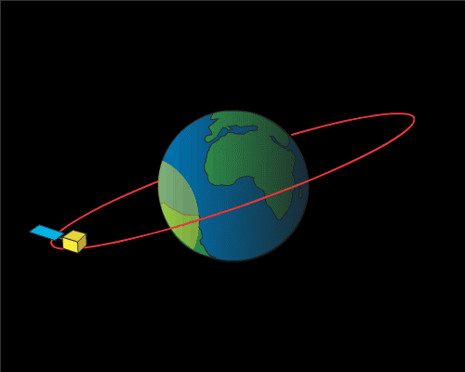
Geostationary Satellites
Geostationary satellites are in orbit about 22,000 miles above the Earth’s equator and spin at the same rate of the Earth
This allows them to continuously gather data from the same location on Earth
Image from NOAA

Slide 3
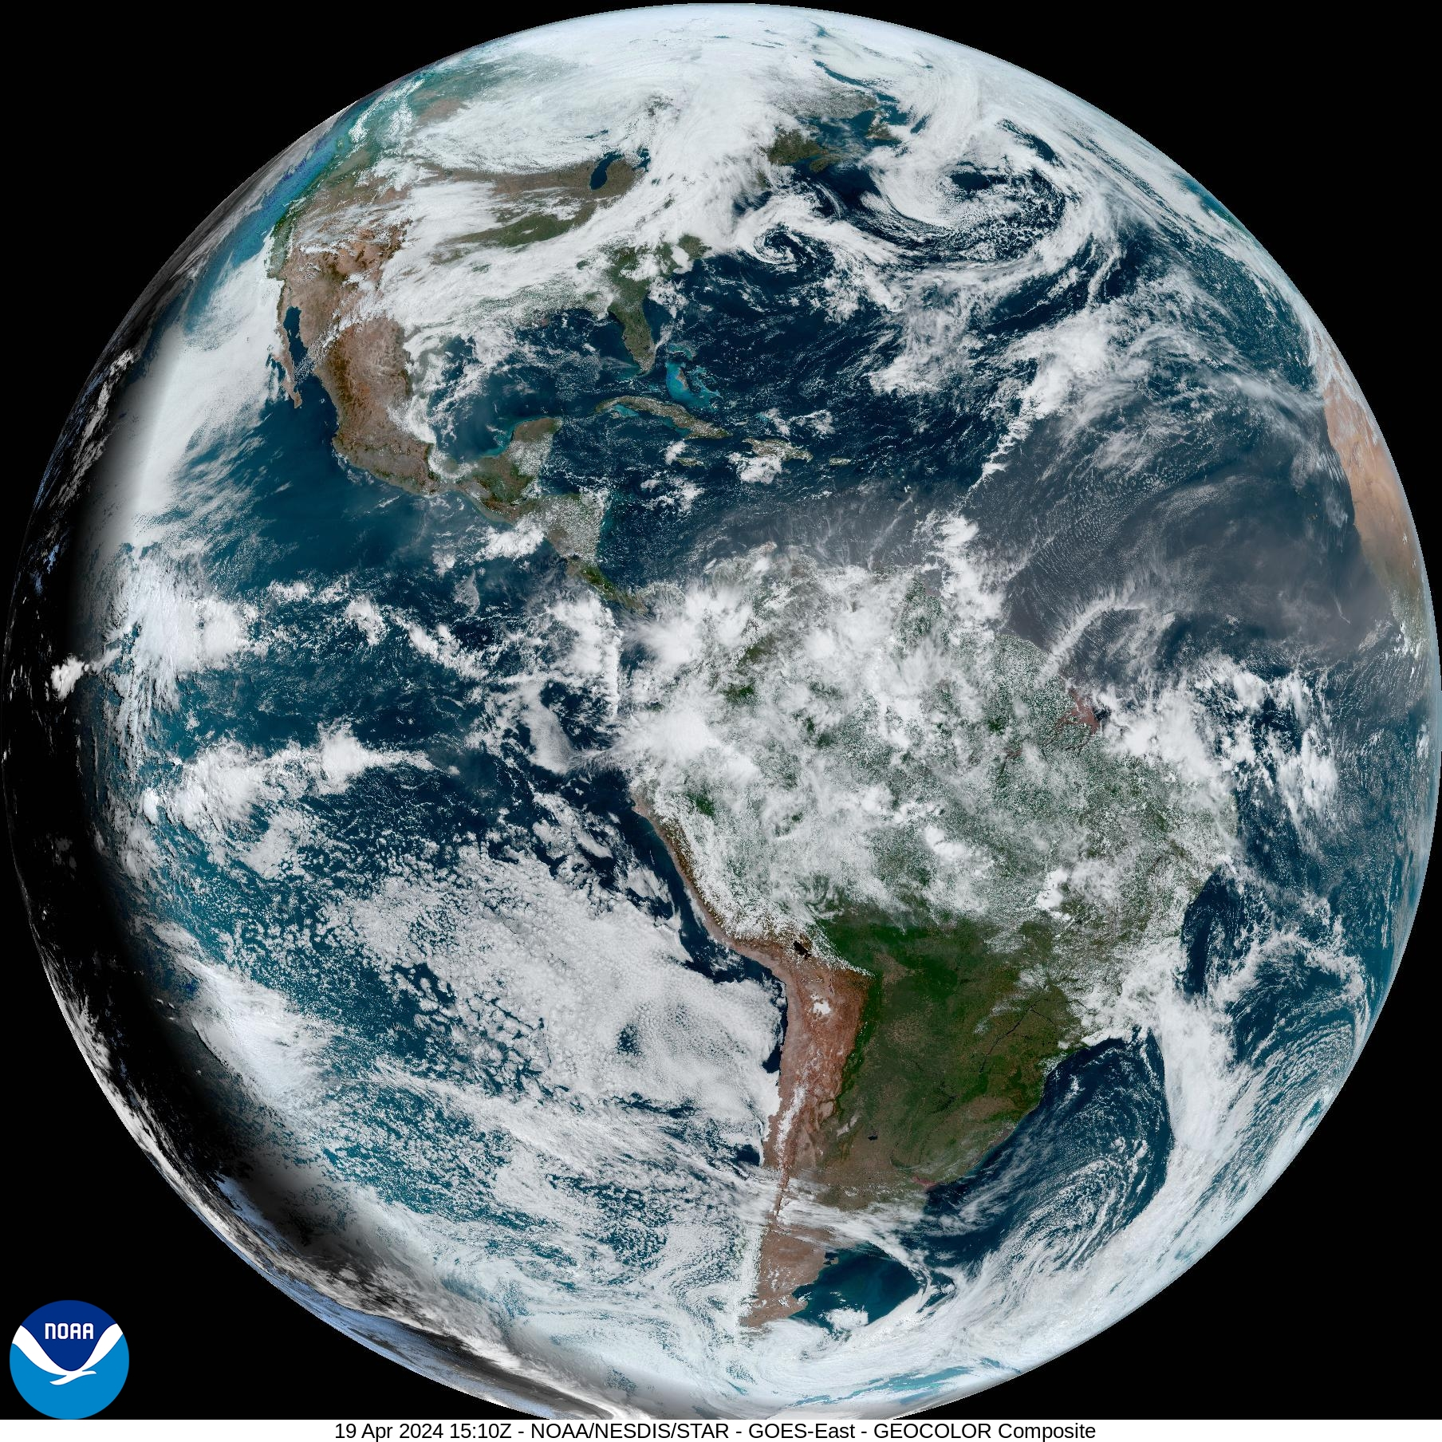
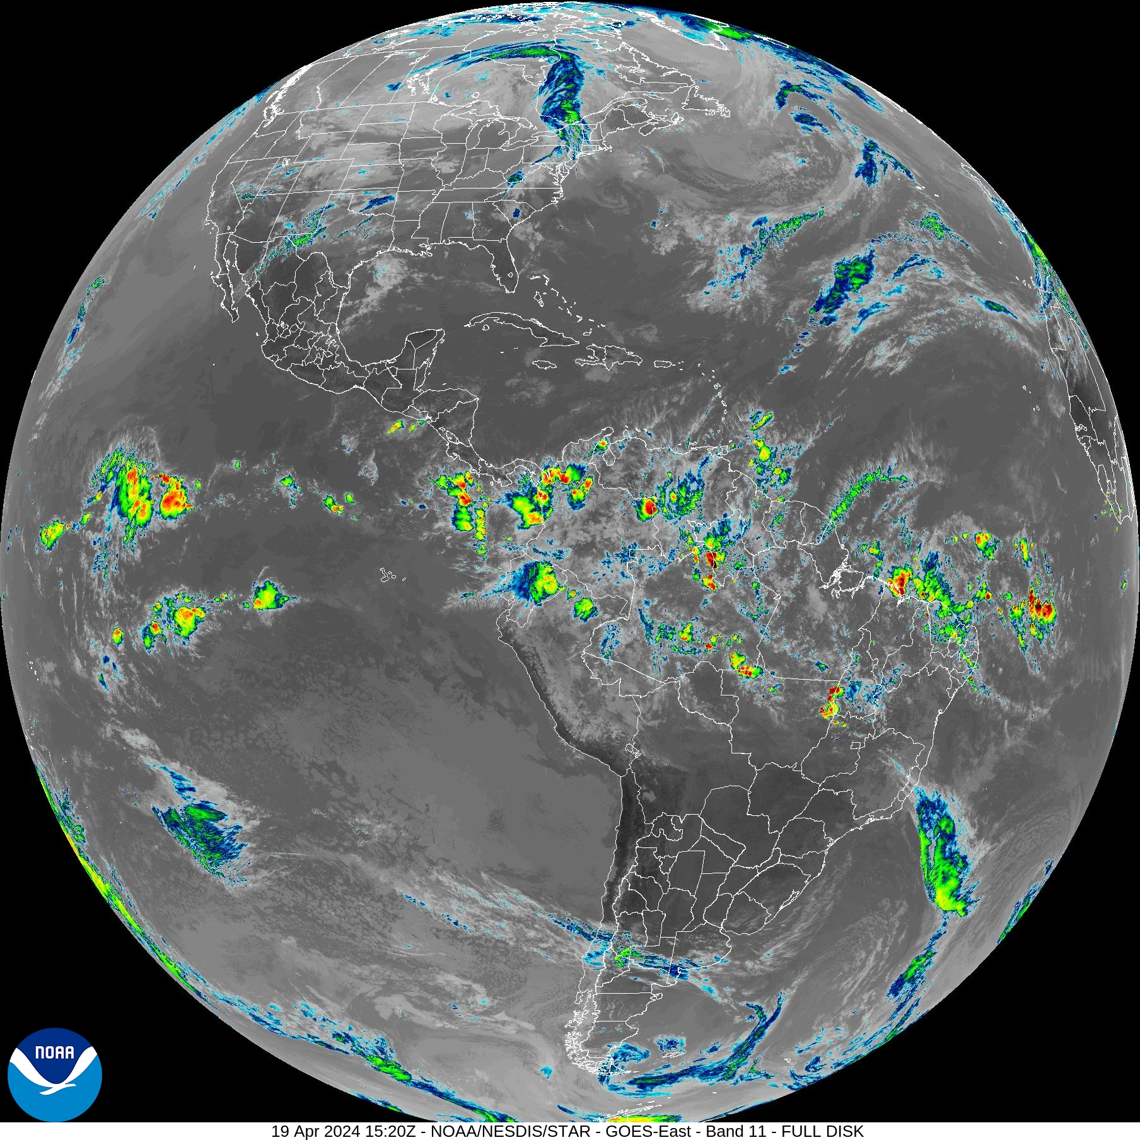
Background
Geostationary satellites take data about every 30 minutes under normal conditions
NOAA GOES-16 Satellite takes data every 10 minutes
Captures data across 16 visual/reflective, near-infrared, and infrared bands
NOAA (April 19, 2024)

Slide 4
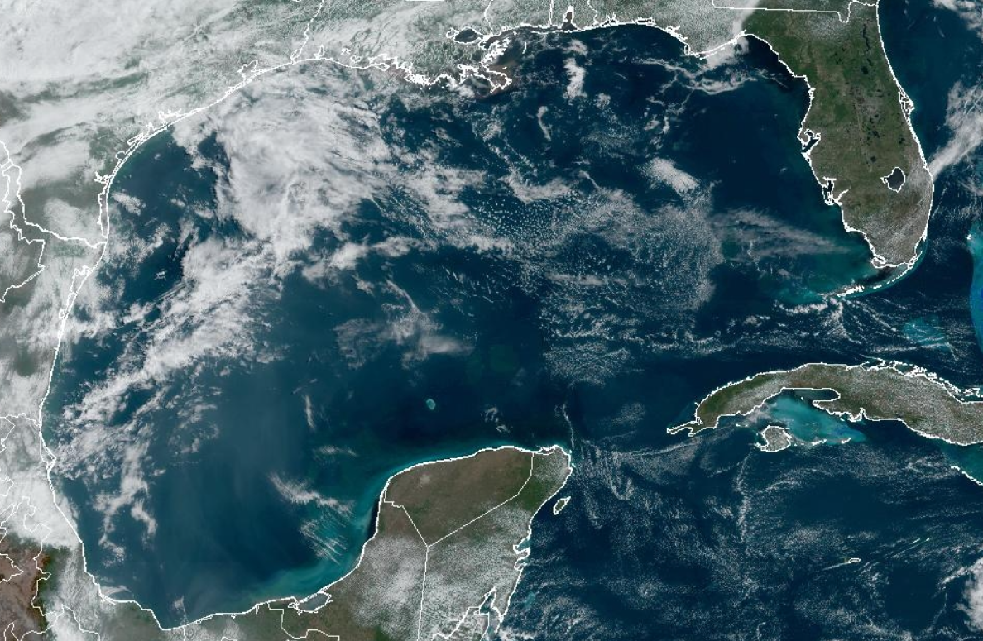
Objectives
Our project looks to use Machine Learning to detect and track clouds specific to the Gulf of Mexico in the Geostationary Operational Environmental Satellite GOES-16.
Create a predictive model that can fill in the missing satellite information between snapshots
Predictive model’s capabilities extend into future cloud movement prediction
Possible tropical storm classification and movement prediction
Notes:
Explain what the GOES satellite is, what is geostationary satellite images? Also our model should extend to other regions later on

Slide 5
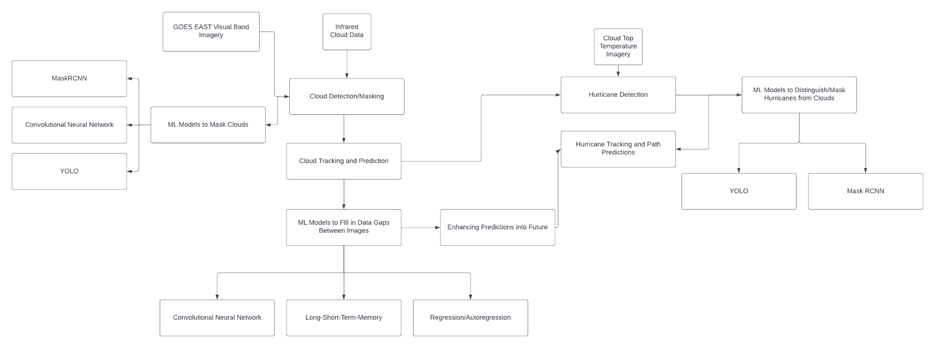
Block Diagram

Slide 6
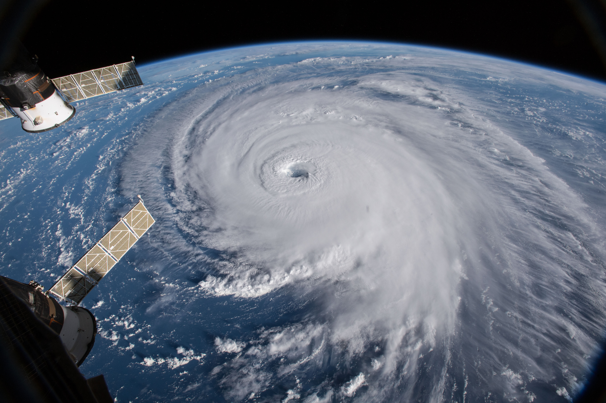
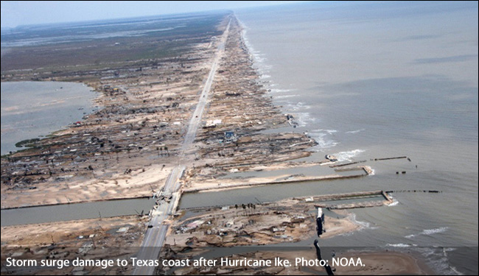
Project Motivation
Fill in missing satellite data for more accurate weather modeling and forecasting
Use this to track hurricanes to warn people sooner of the hurricane’s path
Wikipedia (2024)

Slide 7
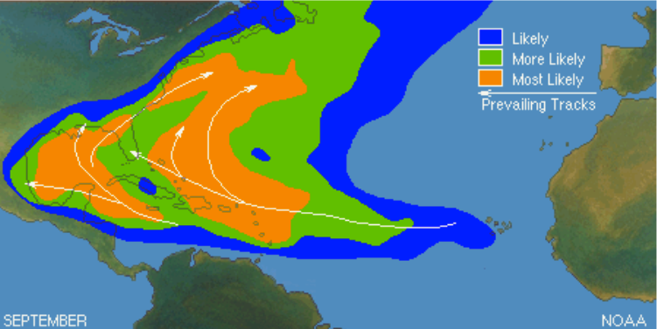
Why the Gulf of Mexico?
Hot spot for hurricanes
Hurricanes “funnel” through Mexico and Cuba
GOES-16 only takes images of the Western Hemisphere

Slide 8
Pre-Processing Approaches: IDE Choice
Pre-processing was initially done in the Earth Engine Code Editor, a Javascript web-based IDE for the Earth Engine API
Integrated data catalog: Direct access to large catalog of satellite imagery and geospatial datasets allowing easy implementation of GOES or SENTINEL-2 imagery preprocessing.
Scalability: GEE Platform handles computational load on Google servers
Real-time data access: Beneficial for time-sensitive projects like monitoring current tropical storm movement

Slide 9
Pre-Processing Approaches: IDE Choice
Pre-processing was eventually moved to Google Colab
Machine Learning Library Support: Colab supports all popular machine learning libraries such as TensorFlow, PyTorch, and Keras
Improves Exporting Time: Easier and more efficient to import/export data directly within Drive

Slide 10
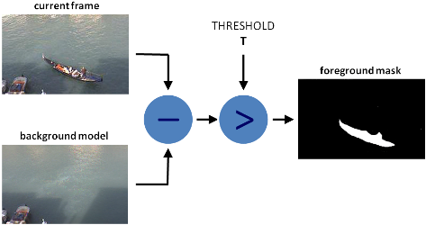
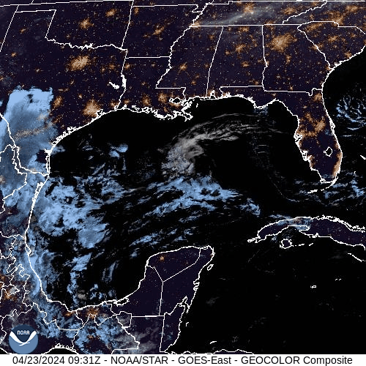
Pre-Processing Approaches: Extracting Clouds
Additive Masking vs Background Subtraction
Building a background would prove difficult and time intensive
Open Source Computer Vision (OpenCV)

Slide 11
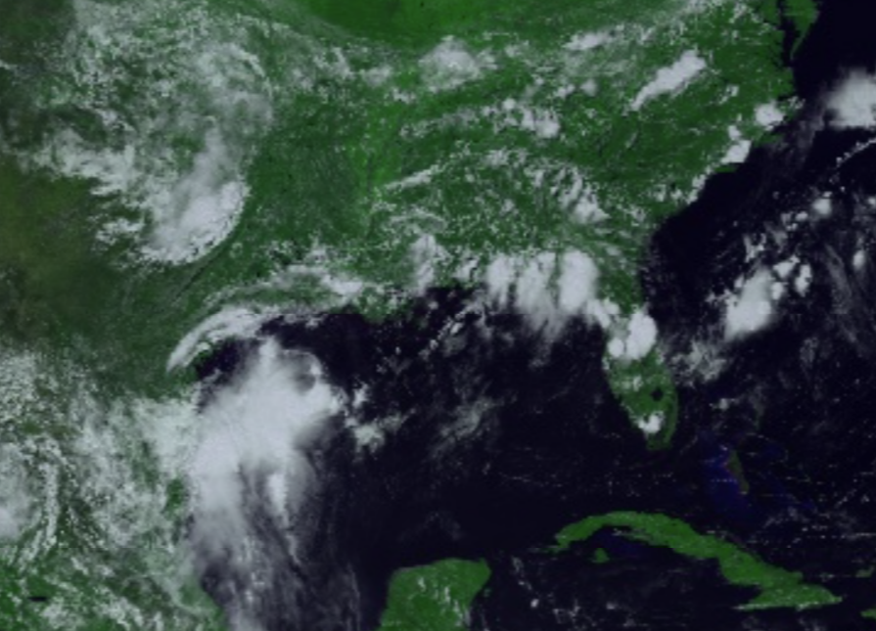
Pre-Processing Approaches: Image Bands
Three Types of Bands:
Visible (450 - 690 nm)
Near-Infrared (846 nm - 2.275 µm)
Infrared (3.80 - 13.6 µm)

Slide 12
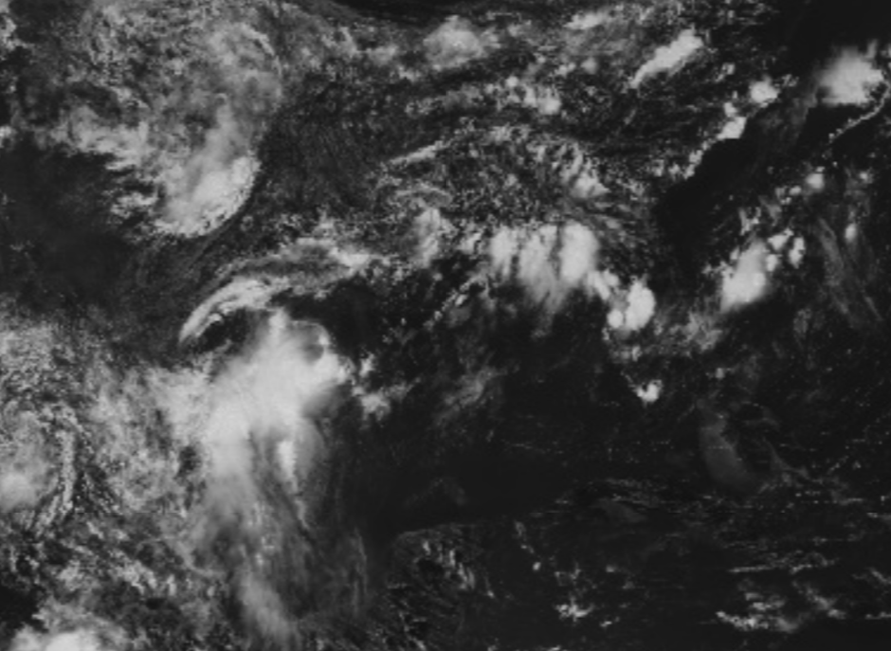
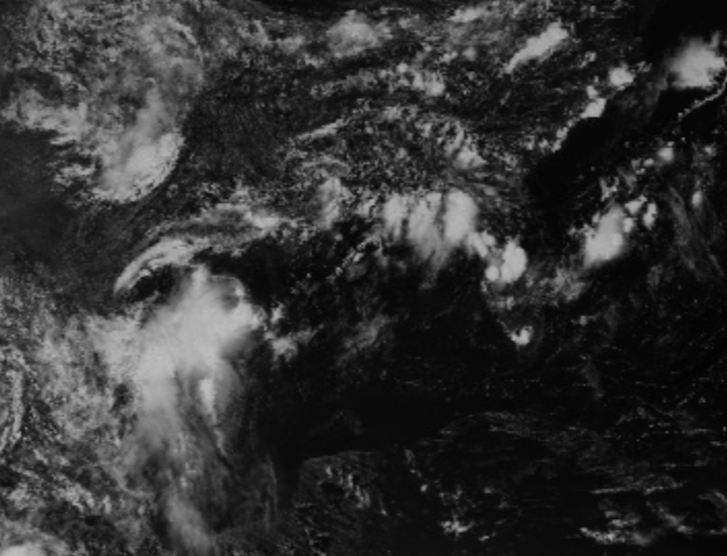
Visible Bands: Visual Blue, Visual Red

Slide 13
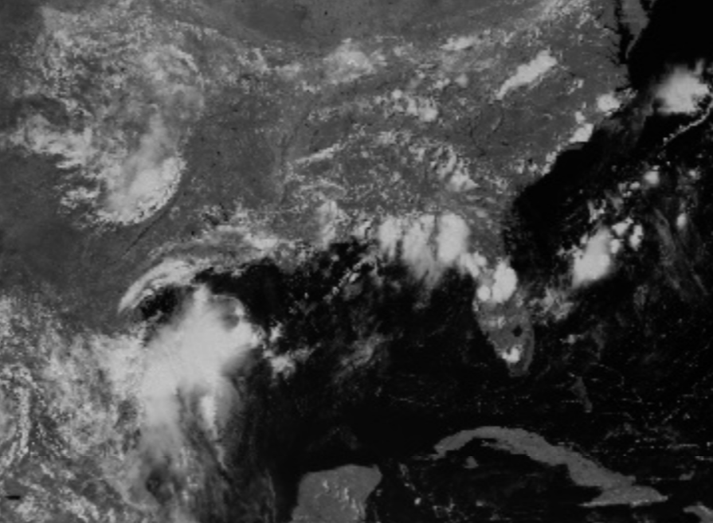
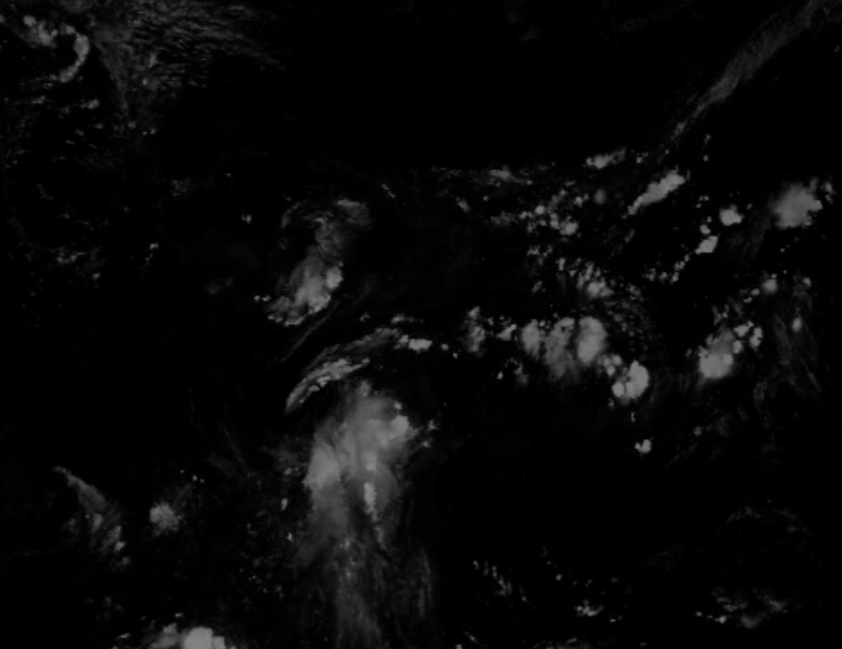
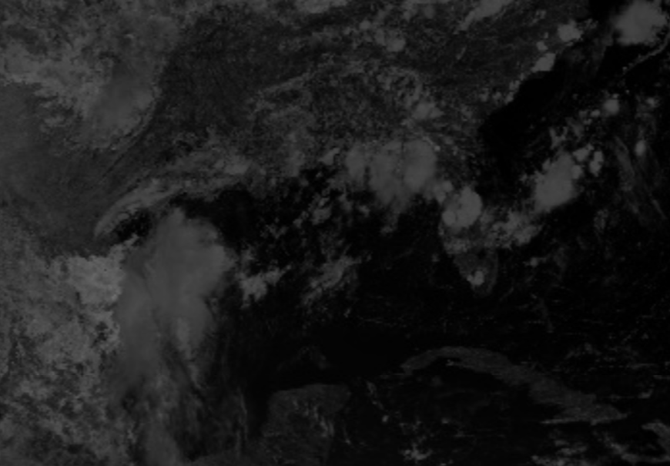
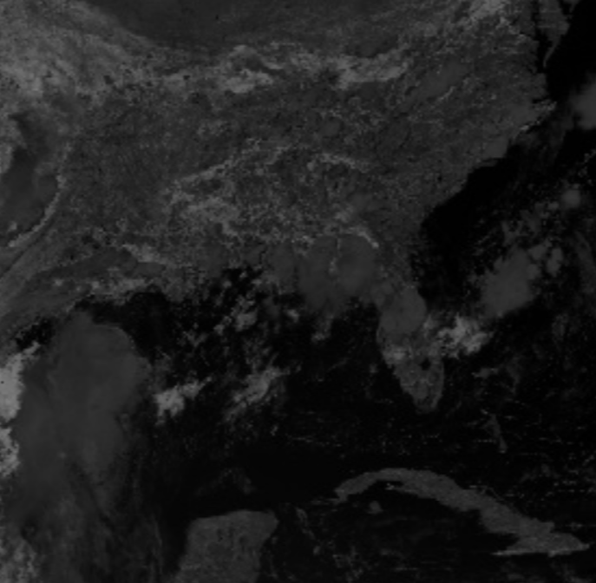
Near-Infrared Bands: Veggie, Cirrus, Snow/Ice, Cloud Particle Size

Slide 14
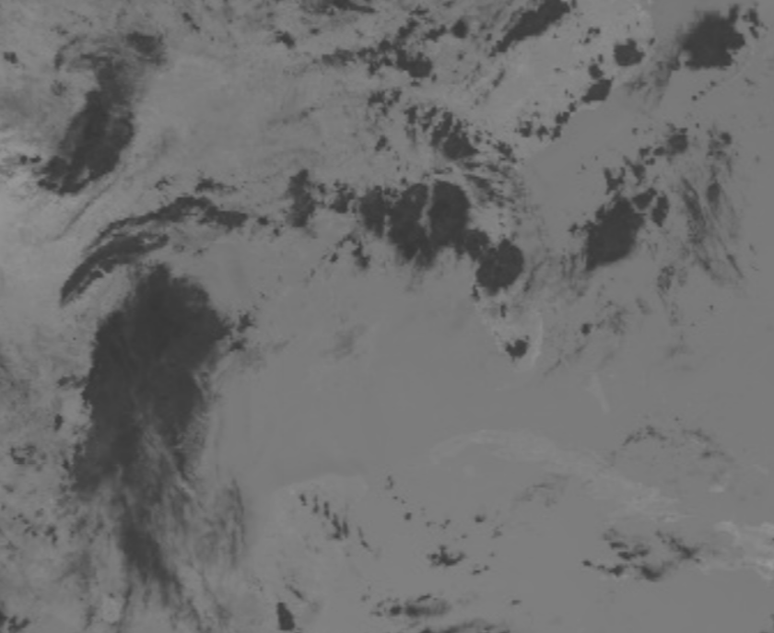
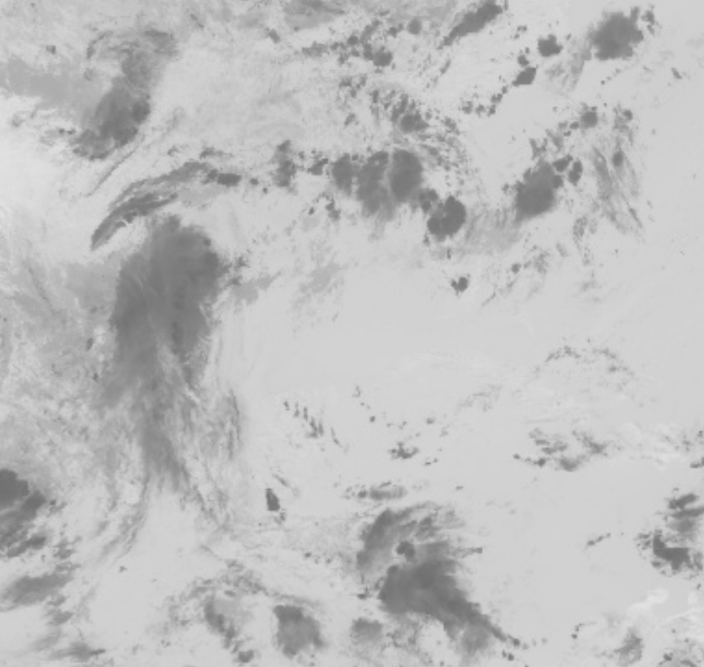
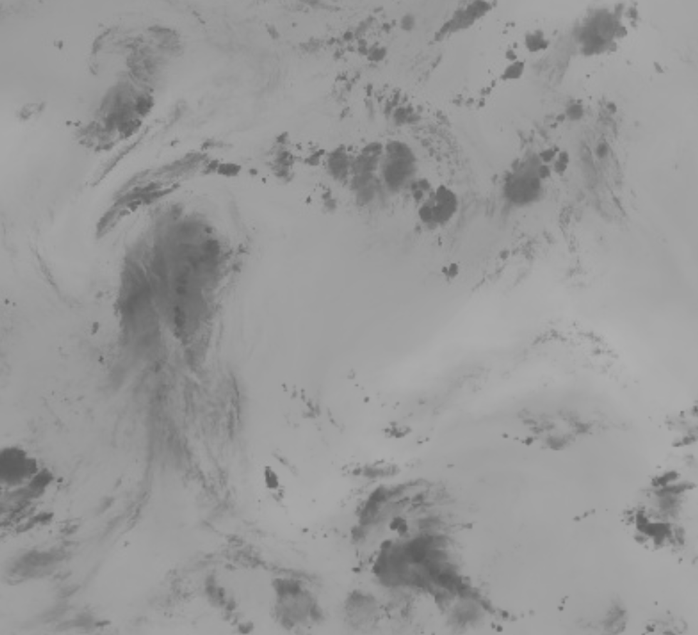
Infrared Bands: Shortwave, Longwave, Water Vapor

Slide 15
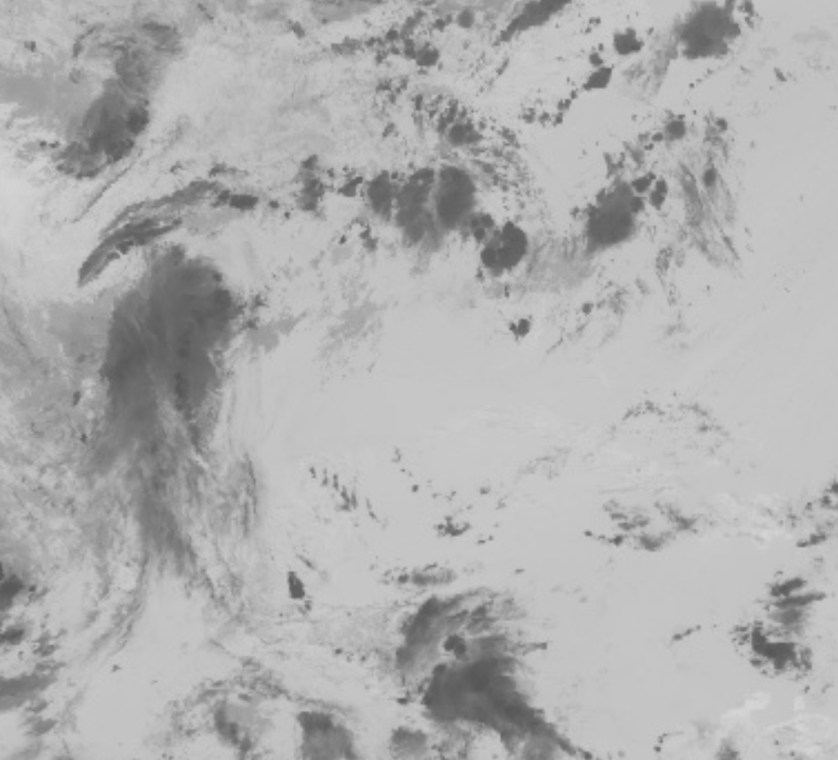
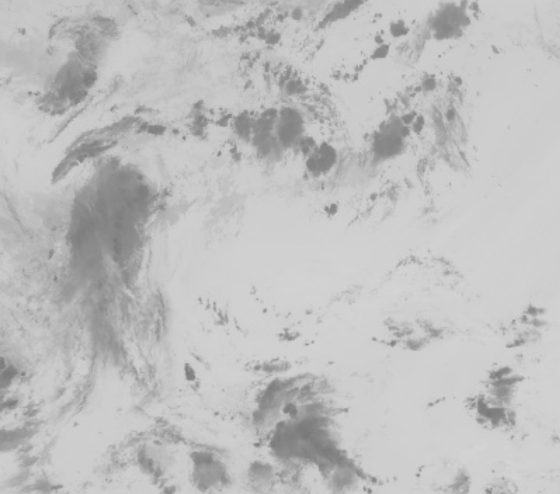
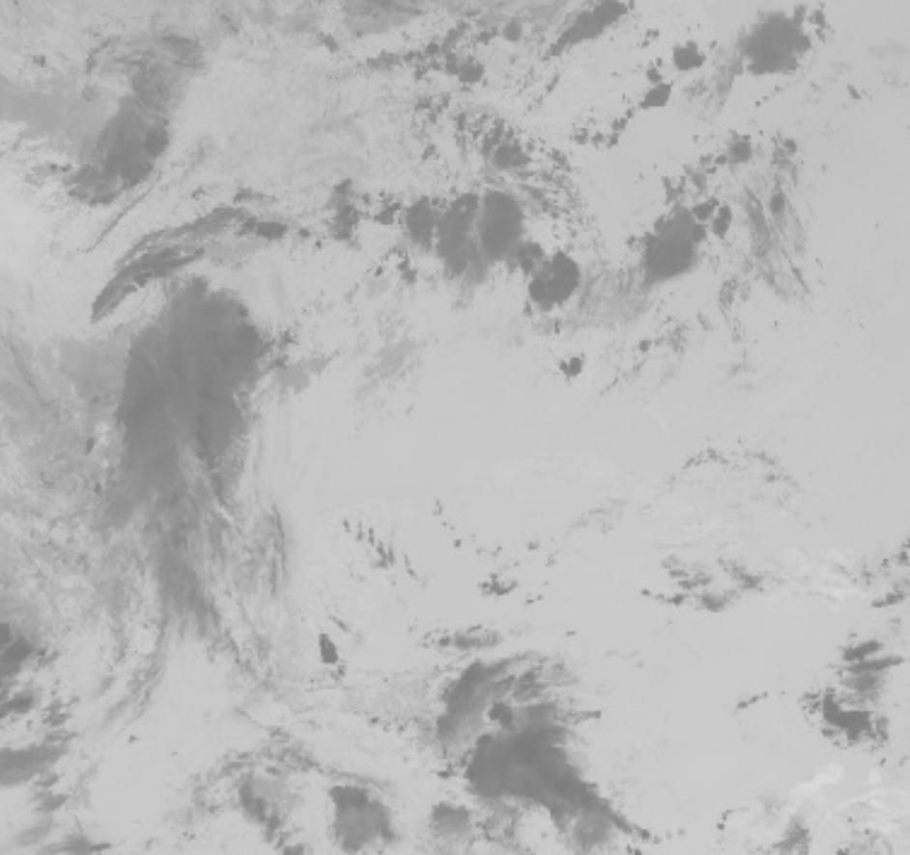
Infrared Bands: Cloud Phase, Ozone, CO2 Longwave

Slide 16
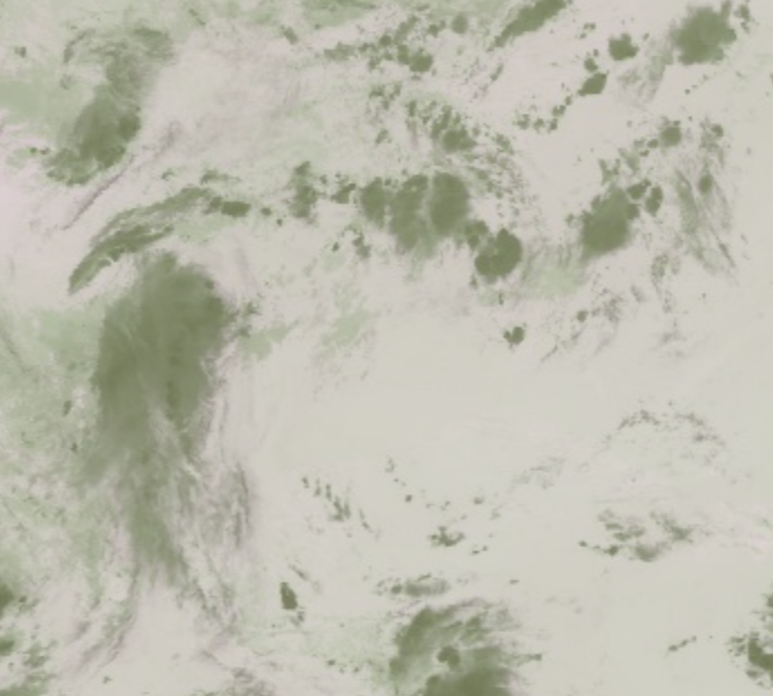
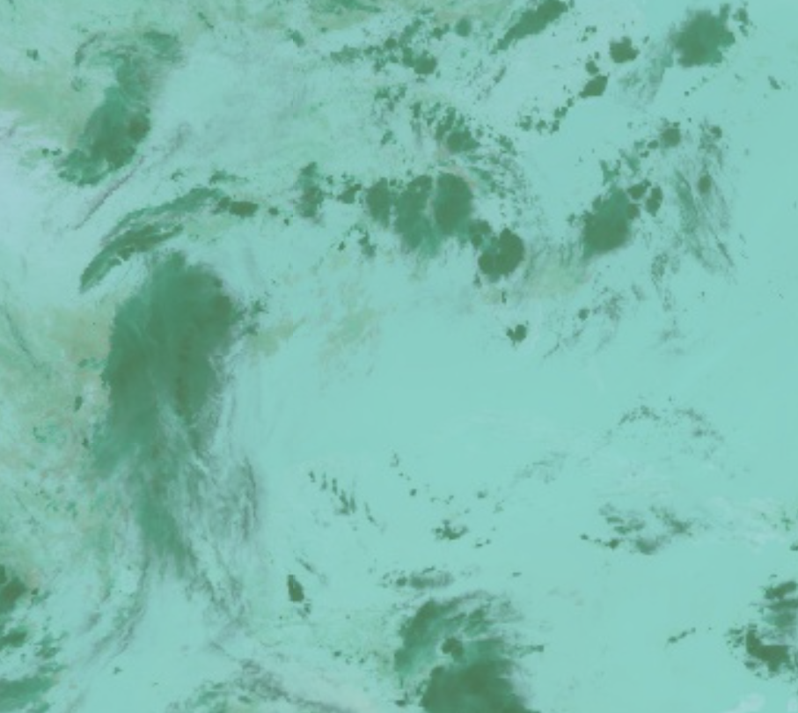
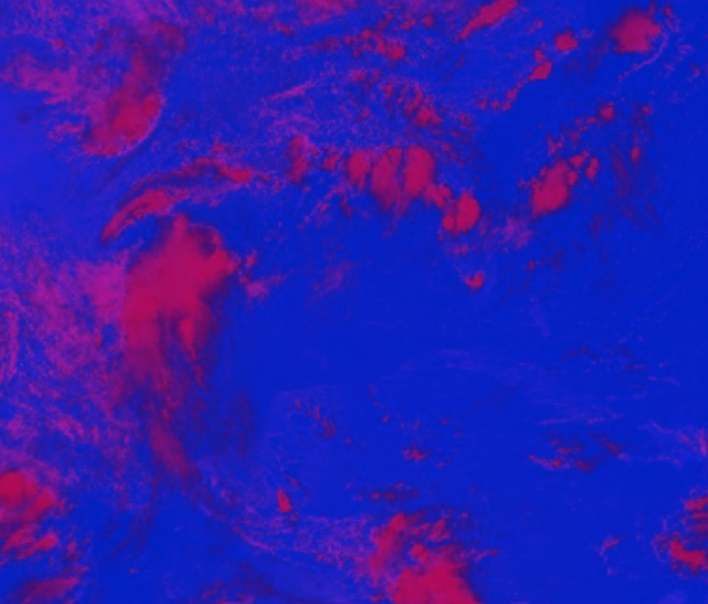
Visible Red, Cloud-top phase
Longwave, CO2, Cloud-top phase
Shortwave, CO2, Cloud-top phase
Tested Combinations

Slide 17
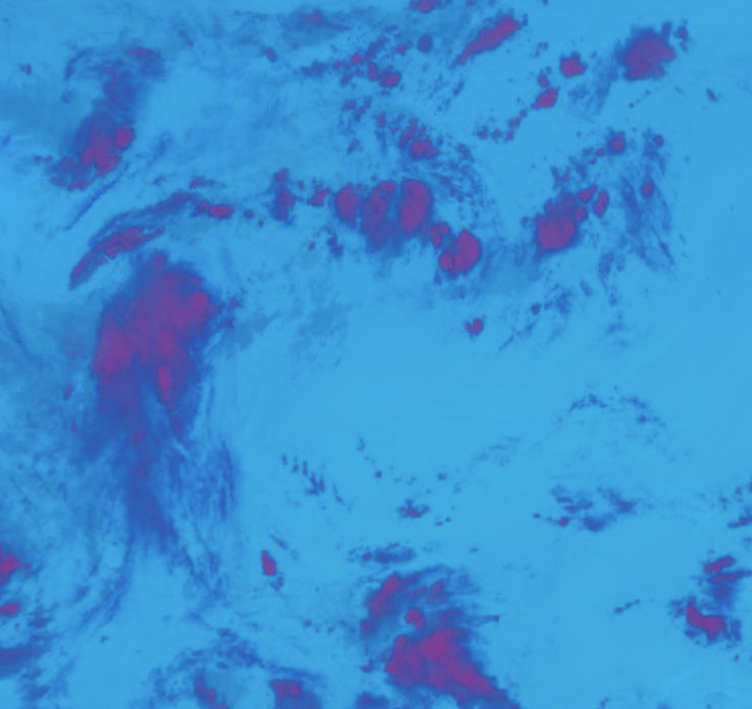
Our Banding Approach
Cirrus, Cloud Phase, CO2 Longwave
Cirrus: Great for excluding land and able to see cirrus clouds, but can only see daytime clouds
Cloud-Top Phase: Can see clouds at any time and get the general shape of each cloud
CO2 Longwave: Able to differentiate clouds by height and aid in night time cloud detection

Slide 18
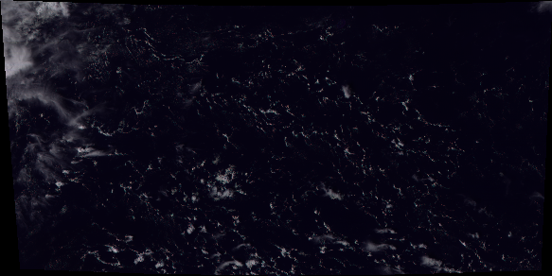
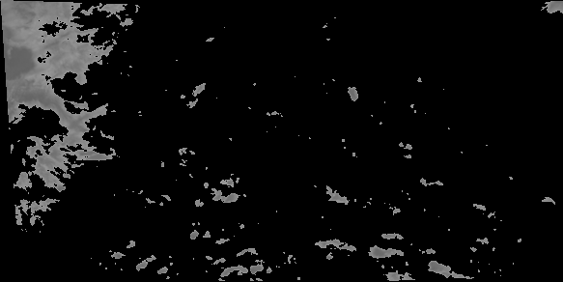
Data Processing Pipeline
RGB Satellite Image
Receive latest GOES image
Apply combination of visual and infrared bands
Use thresholding formula to extract clouds
Export file as a tif and convert it to a png
Grayscale Mask

Slide 19
Machine Learning Approaches: Autoregressive Models
Traditional autoregressive model seemed to be ineffective for filling in the image data between GOES satellite screenshots
AR models typically used for time-series numerical data, not as suitable for capturing the spatial correlations in data like convolutional models
Will continue iterations that perhaps focus more on the predictive aspect of the cloud mask over the missing image filling

Slide 20
Future Forecast for the Project
Initially all work together on finishing Autoregressive model
Divide and conquer approach to create the following ML models:
Convolutional Neural Network (CNN): Effective in visual imagery analysis because they detect spatial hierarchies and features (edges, textures) in images
Long Short-Term Memory (LSTM): Good for applications where data has important temporal relationships over time intervals such as climates or seasonal behaviors
ConvLSTM: Combination of the spatial processing capabilities of CNNs with temporal processing of LSTMs
Notes:
CNN: CNNs are highly effective in processing and analyzing visual imagery due to their ability to detect spatial hierarchies and features (such as edges and textures) in images. This makes CNNs particularly suitable for interpreting and analyzing satellite imagery where spatial patterns, like cloud formations, are key.
LSTM: LSTMs excel in applications where data has important temporal relationships that extend over time intervals, making them ideal for sequence prediction problems like forecasting cloud movement based on historical data.

Slide 21
Questions?

Slide 22
Thank you!

